Slide 1
CMPE 220
Class 17 – System Security
Notes:
Let’s talk about history.
California State Railroad Museum – 1976 - docents worked on original steam engines.

Slide 2
Protection
An operating system must protect users and processes from each other’s activities.
Mechanisms to control the access by programs, processes, or users to the computer system resources.
Each resource object has a unique name and can be accessed through a well-defined set of operations.
Ensure that each object is accessed correctly and only by those processes that are allowed to do so.

Slide 3
Principle of Least Authority (POLA)
A guiding principle of protection.
Give programs, users and systems just enough privileges to perform their tasks.
Limit damage if an entity has a bug or gets abused.
“Need to know”
At any time, a process should be able to access only those resources that it currently requires to complete its task.

Slide 4
Protection Granularity
Rough-grained privilege management is easier and simpler.
Principle of least authority done in large chunks.
Example: Traditional UNIX processes either have abilities of the associated user or of the root user.
Fine-grained management is more complex and more overhead, but more protective.
Examples:
File access control lists (ACLs)
Role-based access control (RBAC)

Slide 5
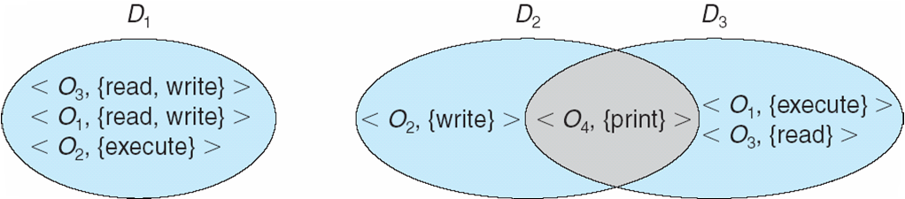
Protection Domains
A domain is a set of resource objects and their allowable operations.
A set of access rights as <object-name, rights-set> pairs
Example: <file F, {read, write}>
Users, processes, and program procedures can be in domains.
Operating System Concepts, 10th edition
by Abraham Silberschatz, Greg Gagne, and Peter B. Galvin
Wiley, 2018, ISBN 978-1119456339

Slide 6
UNIX Domains
In UNIX, a process’s domain is defined by its UID (user ID) and GID (group ID).
A (UID, GID) combination determines:
A complete list of all the accessible resource objects.
Whether they can be read, written, or executed.

Slide 7
UNIX Domains, cont’d
Two processes with the same (UID, GID) combination have access to the same set of objects.
Processes with different (UID, GID) combinations will have access to different but possibly overlapping sets of objects.

Slide 8
UNIX Domain Switching
A system call causes a domain switch from the user’s domain to that of the kernel.
When a process executes a file with the SETUID or SETGID bit on, it acquires the UID or GID of the file owner.
Get a different set of access rights.
The UID and GID are reset when the execution completes.

Slide 9
UNIX Domain Switching, cont’d
Domain switch accomplished via passwords.
The su command temporarily switches to another user’s domain when the other domain’s password is provided.
Domain switching via commands
The sudo command prefix executes a specified command in another domain.

Slide 10
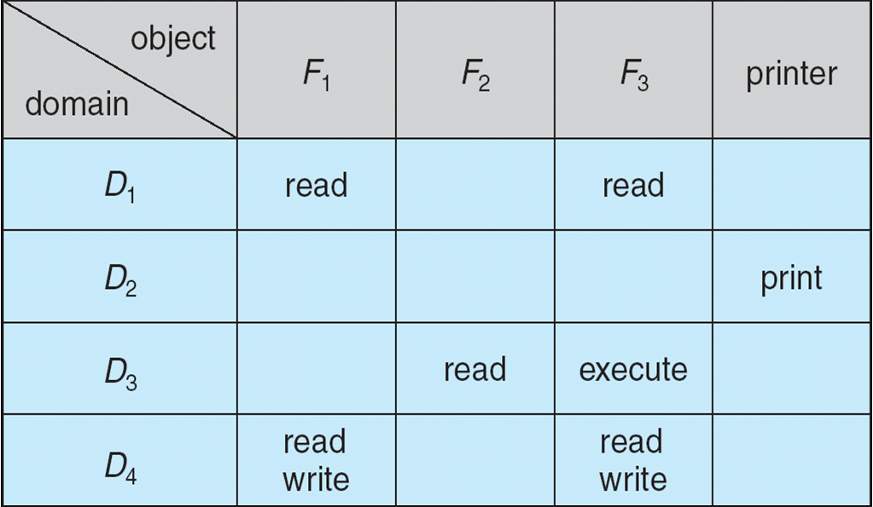
The Access Matrix
Rows represent domains
Columns represent objects
Access(i, j) is the set of operations that a process executing in Domain_{i} can invoke on Object_{j}
Operating System Concepts, 10th edition
by Abraham Silberschatz, Greg Gagne, and Peter B. Galvin
Wiley, 2018, ISBN 978-1119456339

Slide 11
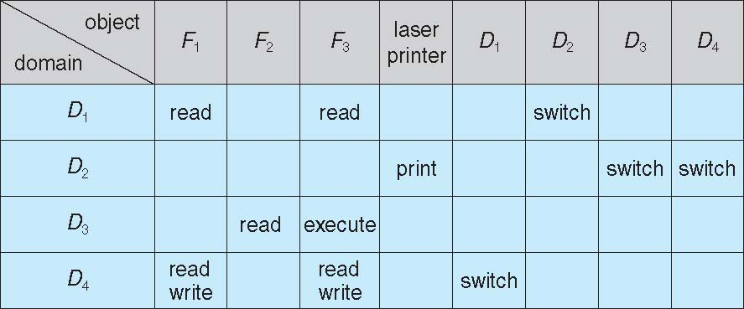
The Access Matrix, cont’d
Domains are also objects.
Allow switching operations between domains.
The access matrix is generally very sparse.
Can be implemented in other more efficient ways.
Operating System Concepts, 10th edition
by Abraham Silberschatz, Greg Gagne, and Peter B. Galvin
Wiley, 2018, ISBN 978-1119456339

Slide 12
The Access Matrix, cont’d
Separate mechanism from policy.
Mechanism
The OS provides access matrix + rules.
The OS ensures that the matrix is only manipulated by authorized agents and that rules are strictly enforced.
Policy
User dictates policy.
Who can access what object and in what mode.

Slide 13
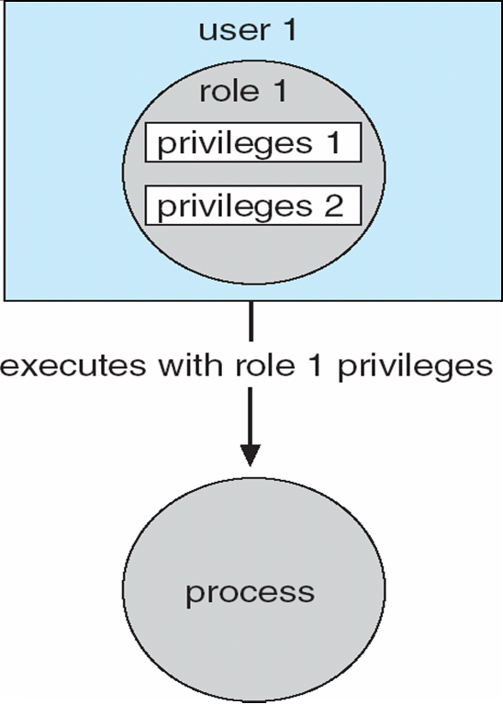
Role-Based Access Control (RBAC)
Implements the principle of least authority.
Users are assigned roles that grant access to privileges and programs
Enable a role via a password to gain its privileges.
Operating System Concepts, 10th edition
by Abraham Silberschatz, Greg Gagne, and Peter B. Galvin
Wiley, 2018, ISBN 978-1119456339

Slide 14
Program-Level Protection
Programming languages can have built-in protection mechanisms.
Allow the high-level description of policies for the allocation and use of resources.
Provide software for protection enforcement when automatic hardware-supported checking is unavailable.

Slide 15
Security
Protection mechanisms protect against internal problems.
Security measures protect against external threats.

Slide 16
Security Violations
Breach of confidentiality
Unauthorized reading of data.
Breach of integrity
Unauthorized modification of data.
Breach of availability
Unauthorized destruction of data.

Slide 17
Security Violations, cont’d
Theft of service
Unauthorized use of resources.
Denial of service (DOS)
Prevention of legitimate use.

Slide 18
Security Violation Methods
Masquerading (breach authentication)
Pretend to be an authorized user to escalate privileges.
Replay attack
With or without message modification.
Session hijacking
Intercept an already-established session to bypass authentication.

Slide 19
Security Violation Methods
Man-in-the-middle attack
An intruder sits in data flow to masquerade as the sender in order to fool the receiver, and vice versa.

Slide 20
The Bad Guys
“Script kiddies”
“Hackers” who run malicious scripts that are shared among the hacker communities.
Can be thwarted by “honey pots”
Fake data at a site designed to lure hackers.
Best defense: up-to-date software
Corporate thieves
Steal confidential data from competitors.
Hostile (or friendly) governments
Snooping and monitoring
Spying

Slide 21
Layers of Security
It is impossible to have absolute security.
Make the cost to the perpetrator sufficiently high to deter most intruders.
Security is as strong as the weakest link in the chain.
But can too much security be a problem?

Slide 22
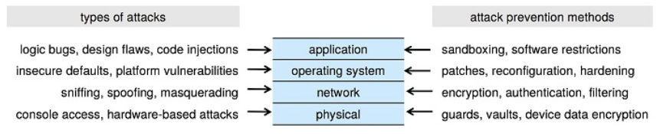
Layers of Security, cont’d
Operating System Concepts, 10th edition
by Abraham Silberschatz, Greg Gagne, and Peter B. Galvin
Wiley, 2018, ISBN 978-1119456339

Slide 23
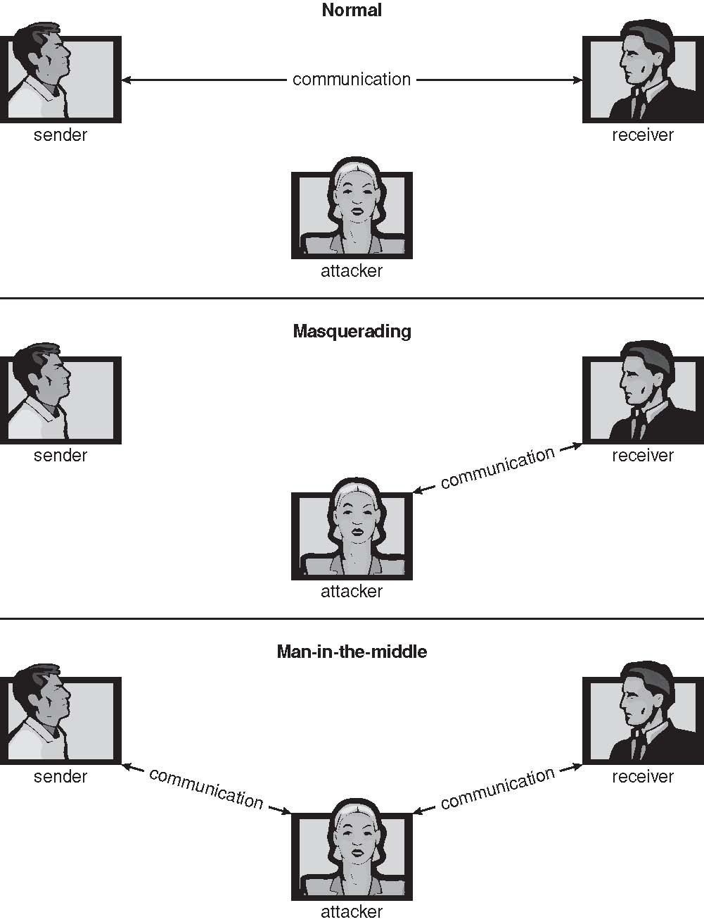
Man (or Woman) in the Middle Attack
Operating Systems Concepts, 9th edition
Silberschatz, Galvin, and Gagne
(c) 2013 John Wiley & Sons. All rights reserved. 978-1-118-06333-0

Slide 24
Trojan Horse Attack
A program written by one user can execute in another user’s environment.
The program gains the other user’s access rights.
The program misuses those rights.
A long UNIX path names exposes each directory on the path.
A path that includes “.” when used in another user’s directory can give a program access to the other user’s home directory.

Slide 25
Trojan Horse Attack, cont’d
Examples:
spyware
pop-up browser windows
browser plug-ins
covert channels
Up to 80% of spam is delivered by spyware-infected systems.

Slide 26
Trap Door Attack
Specific user identifier or password that circumvents normal security procedures.

Slide 27
Logic Bomb
A program initiates a security incident under certain circumstances.
Developed by a disgruntled programmer.
Must enter a password daily to prevent the bomb from going off.
If the programmer is fired, the bomb explodes.
Must hire the programmer back as an expensive consultant to “solve” the problem.

Slide 28
Stack and Buffer Overflow
Exploit a bug in a program to gain unauthorized user or privilege escalation.
Overflow either the stack or memory buffers.
Fail to check bounds on inputs or arguments.
Write past the arguments on the stack into the return address on stack.
When routine returns from a function call, it returns to a hacked address.

Slide 29
Viruses
A malicious code fragment embedded in a legitimate program.
Self-replicating, designed to infect other computers.
Very specific to CPU architecture, operating system, applications.
Usually borne via email or as a macro.

Slide 30
Categories of Viruses
Parasitic file
Boot
Macro
Source code
Polymorphic
Avoids having a virus signature
Encrypted
Encrypted to avoid detection.
Decrypts to execute.

Slide 31
Categories of Viruses, cont’d
Stealth
Modifies parts of the system that can be used to detect it.
Tunneling
Installs in the interrupt-handler chain or in device drivers.
Multipartite
Infect multiple parts of a system.
Armored
Hard for antivirus researchers to detect.

Slide 32
Ransomware
A virus that encrypts important data on a user’s computer system.
The villain demands payment (often in bitcoins) for the decryption key.
Threaten to post stolen private data on the web.
The villain demands payment (often in bitcoins) or the data will be made public.

Slide 33
Keystroke Logger Virus
A virus that intercepts keystrokes.
Records passwords, etc.
Sends confidential information to a malicious recipient.

Slide 34
Port Scanning
Automated attempt to connect to a range of ports on one IP address or on a range of IP addresses.

Slide 35
Denial of Service
Overload the targeted computer to prevent it from doing any useful work.
A distributed denial-of-service (DDOS) comes from multiple sites at once.
“Ping” of death.
Consider traffic to a web site.
How can you tell the difference between being a target and being really popular?
Accidental: Students writing bad fork() code.

Slide 36
Design Principles for Security
The system design should be public.
The default should be no access.
Check for current authority.
Give each process the least authority possible.
The protection mechanism should be simple, uniform, and built into the lowest layers of the system.
The scheme chosen must be psychologically acceptable.

Slide 37
User Authentication: Passwords
Passwords are often easy to guess.
A classic research study compiled a list of likely passwords.
first and last names
street and city names
words from a moderate-sized dictionary
license plate numbers
short strings of random numbers
Discovered that over 86% of passwords then in use were in their list.

Slide 38
Best Passwords
Upper case, lower case, digit, symbol
Hard to remember, so users write it down
Very difficult to enter on smartphones
A long text string
Easy to remember, easy to type

Slide 39
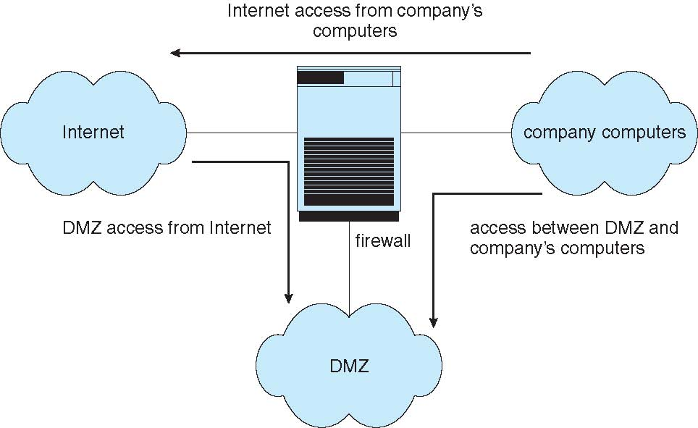
Security Firewalls
Operating System Concepts, 10th edition
by Abraham Silberschatz, Greg Gagne, and Peter B. Galvin
Wiley, 2018, ISBN 978-1119456339

Slide 40
The Biggest Risk to Computer Security
PEOPLE!
Nefarious
Dumb

Slide 41



Nontechnical Security Lecture
Sending data such as email messages to each other via the Internet …
… is like sending postcards via the U.S. mail system.
Anyone can read the message along the way!
We plan to manufacture 7 million widgets next quarter.
Jill
John

Slide 42

Security, cont’d
We plan to manufacture 7 million widgets next quarter.
Jill
John
Bart
How can we keep the nefarious Bart from reading confidential messages that Jill and John are sending each other?

Slide 43
The Shared Secret
Jill needs to send a message containing the confidential data 7 to John.
John and Jill can agree ahead of time to a shared secret – the number 12.
Then Jill can encrypt the data by adding 12 to the confidential data 7.
John decrypts the data by subtracting 12.
19
John
Shared
secret 12
Jill
Shared
secret 12

Slide 44
The Shared Secret, cont’d
19
John
Shared
secret 12
Jill
Shared
secret 12
Bart
Because Bart doesn’t know the shared secret 12, he won’t be able to decrypt the message and obtain the confidential data 7.

Slide 45
The Shared Secret, cont’d
19
John
Shared
secret 12
Jill
Shared
secret 12
But this shared secret solution has problems.
Jill and John must arrange beforehand to share the secret 12.
What if Jill doesn’t already know John?
What if Jill wants to send the confidential data to all her vice presidents at the same time?
How can Jill and her recipients share a secret?

Slide 46
Public Key Cryptography, cont’d
How can Jill and her recipients share a secret number in order to encrypt the confidential data?
A security scheme called public key cryptography was invented just for this purpose.
In this simplified introduction, let’s pretend that multiplication is a one-way operation.
Once you’ve multiplied two numbers, say 4x5=20, you can’t recover the original numbers by dividing.
In other words, you can’t do 20÷4=5 or 20÷5=4

Slide 47
Public Key Cryptography, cont’d
Jill chooses a private key.
Let’s suppose Jill chooses 10.
Each person to whom Jill wants to send confidential data also chooses a private key.
Let’s suppose John chooses 8.
Private key 10
Jill
John
Private key 8

Slide 48
Public Key Cryptography, cont’d
Private key 10
Jill
John
Private key 8
Public
key 5
Bart
Now Jill announces a public key.
Let’s suppose the public key is 5.
Everyone can see the public key.
Including the nefarious Bart.

Slide 49
Public Key Cryptography, cont’d
Jill’s
public-private
key 50
John’s
public-private
key 40
Private key 10
Jill
John
Private key 8
Public
key 5
Now Jill can create her public-private key.
She multiplies her private key by the public key: 10x5=50.
John creates his public-private key.
He multiplies his private key by the public key: 8x5=40.

Slide 50
Public Key Cryptography, cont’d
Jill’s
public-private
key 50
John’s
public-private
key 40
Private key 10
Jill
John
Private key 8
Public
key 5
Remember that we’re pretending that multiplication is a one-way operation.
We cannot discover Jill’s private key 10 by dividing her public-private key 50 by the public key 5.
We cannot discover John’s private key 8 by dividing his public-private key 40 by the public key 5.

Slide 51
Public Key Cryptography, cont’d
Jill’s
public-private
key 50
John’s
public-private
key 40
Private key 10
Jill
John
Private key 8
Public
key 5
What is the goal of all this?
To create a shared secret between Jill and John.
Jill multiplies John’s public-private key by her private key: 40x10=400
John multiplies Jill’s public-private key by his private key: 50x8=400

Slide 52
Public Key Cryptography, cont’d
Shared
secret 400
Jill’s
public-private
key 50
John’s
public-private
key 40
Shared
secret 400
Private key 10
Jill
John
Private key 8
Public
key 5
Now Jill and John have a shared secret 400.
Jill can encrypt the confidential data 7 by adding the shared secret 400.
John can decrypt the confidential data 7 by subtracting the shared secret 400.

Slide 53
Public Key Cryptography, cont’d
407
John
Shared
secret 400
Jill
Shared
secret 400
Bart
Bart can’t decrypt the 407 because he doesn’t know the shared secret 400.

Slide 54
Public Key Cryptography, cont’d
Public key encryption works with multiple recipients.
Jill needs to send confidential data to both John and his twin brother Mark.
Each picks a private key.
Mark
Private key 2
Private key 10
Jill
John
Private key 8

Slide 55
Public Key Cryptography, cont’d
Jill announces the public key 5, and everyone generates his or her public-private key.
Jill: 10x5=50
John: 8x5=40
Mark: 2x5=10
Mark’s
public-private
key 10
Mark
Private key 2
Public
key 5
Jill’s
public-private
key 50
John’s
public-private
key 40
Private key 10
Jill
John
Private key 8

Slide 56
Public Key Cryptography, cont’d
Jill will have a shared secret with each recipient.
Jill and John will share 400 between them, as before.
Jill and Mark will have a different shared secret.
Jill: Multiply Mark’s public-private key by her private key: 10x10=100.
Mark: Multiply Jill’s public-private key by his private key: 50x2=100
Mark’s
public-private
key 10
Shared secret with Jill: 100
Mark
Private key 2
Public
key 5
Jill’s
public-private
key 50
John’s
public-private
key 40
Shared secret with Jill: 400
Shared secret with John: 400
Private key 10
Jill
John
Private key 8
Shared secret with Mark: 100

Slide 57
Public Key Cryptography, cont’d
Jill sends to each recipient.
Bart can’t decrypt the messages to recover the confidential data 7 because he doesn’t know the shared secrets.
Shared secret with Jill: 100
Mark
107
Shared secret with John: 400
407
Shared secret with Jill: 400
Jill
John
Shared secret with Mark: 100
Bart

Slide 58
Cryptography in the Real World
Of course, in the real world, we can’t use simple operations like multiplication and addition to generate keys and to encrypt data.
Multiplication and addition are not one-way operations.
Real-world encryption uses very large prime numbers and modulo arithmetic.
Not even today’s most powerful supercomputer can undo such operations.
Worry: Can quantum computers in the future?

Slide 59
When is Cryptography Used?
Public key cryptography is a key exchange protocol first published by Whitfield Diffie and Martin Hellman in 1976.
It was actually invented earlier in 1970 by the British government, but it was classified.
Whenever you visit a secure website, you are using the Diffie-Hellman protocol or a variant.
A secure website has a URL that starts with https: instead of http:

Slide 60
Computer Security as a Career
Cybersecurity is a hot field.
Computers are used everywhere.
Big data.
Privacy issues.

